Slide 1
Using AI against DeepFakes
SwissHacks 2024

Slide 2
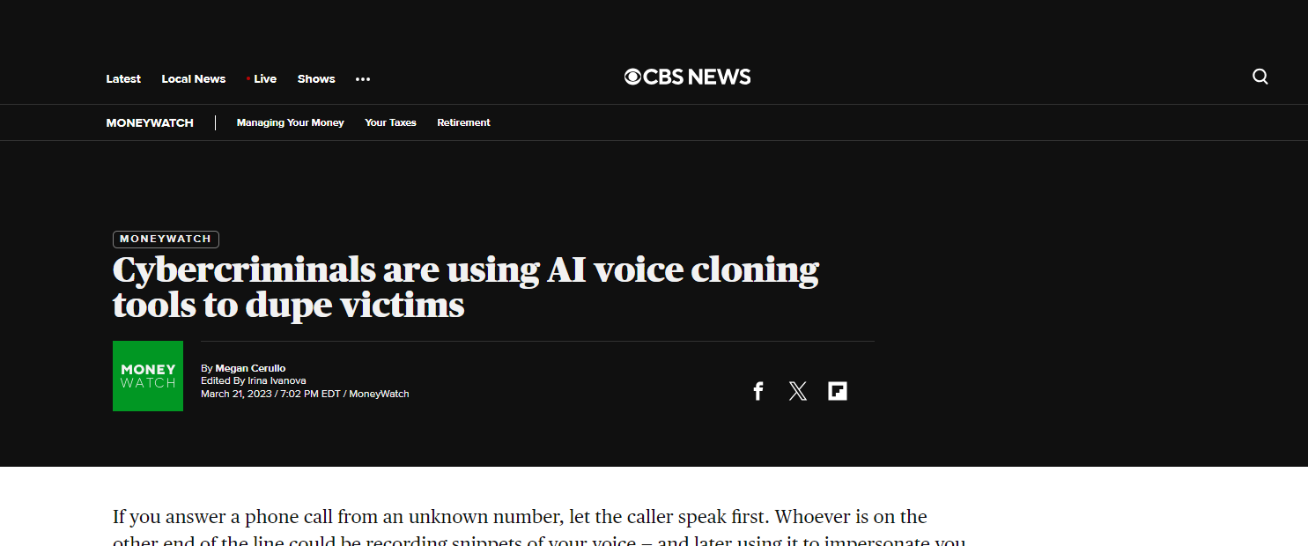
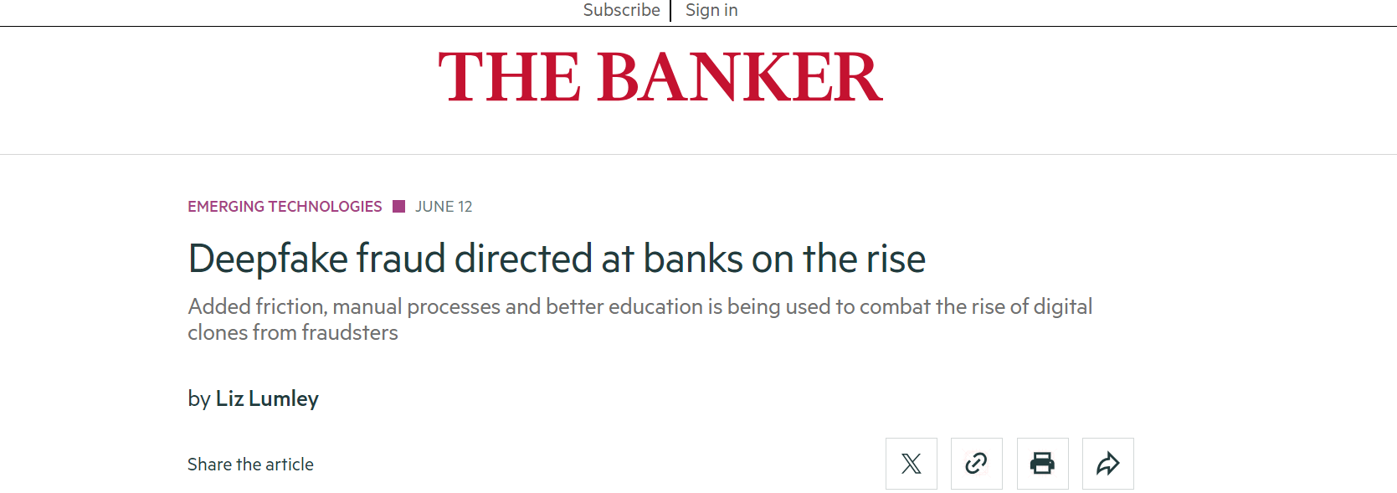
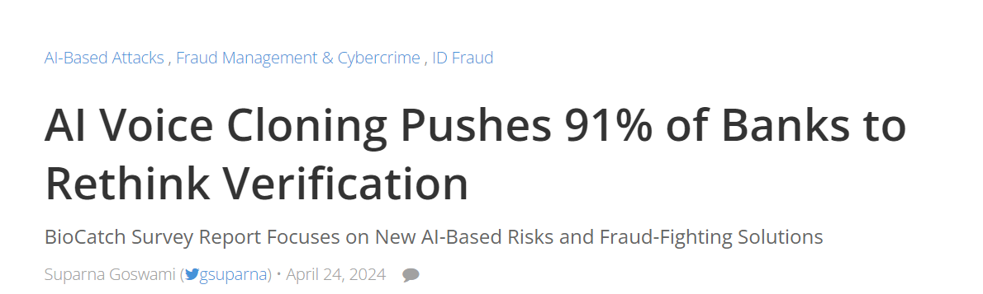
Business Problem
Recent AI developments gave rise to new ways to interfer with ongoing banking operations
Distinguishing between real and fake calls will be of crucial importance
Proactively addressing this in a data-driven way is the only scalable approach that allows to tackle the problem

Slide 3
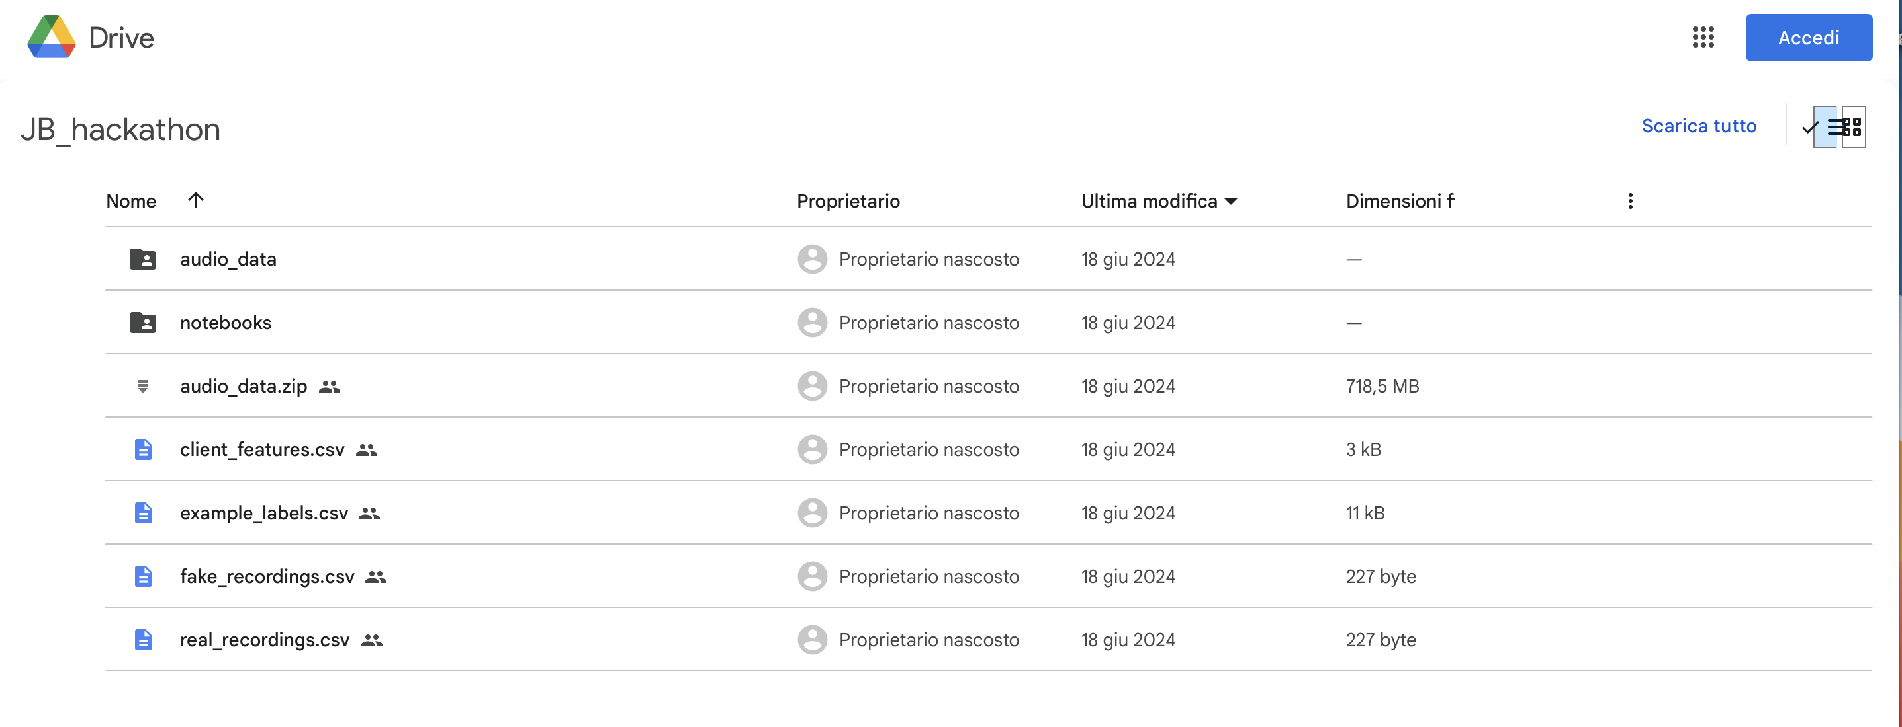

Provided Data
What data will be provided to solve the tasks?
20 client profiles, e.g. including name, profession, tax residency…
Fake and real audio recordings of short requests from clients
Small subset of labelled recordings for fake and real
Do you know which is real and which is fake?
Notes:
Left is fake, right is real!!

Slide 4




Challenge in Detail
Your tasks
Identify deepfake client calls
Verify the client’s identity based on the factual content of the call
Differentiate between distinct human voices

Slide 5
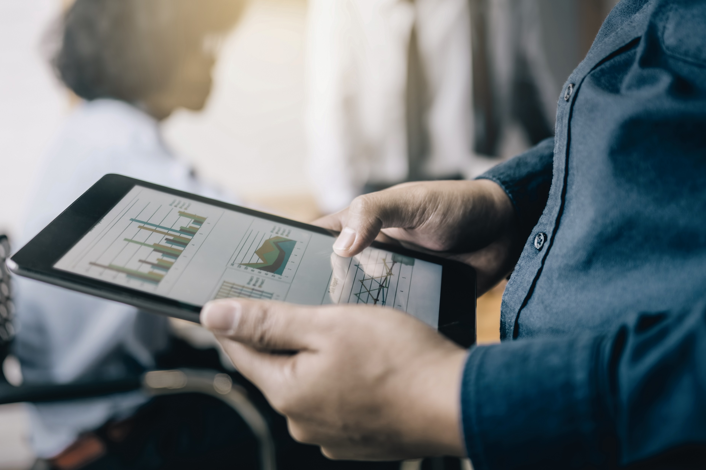

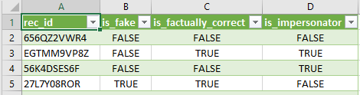
Evaluation
What you will be scored upon?
50% Prediction score
50% Solution approach
What goes into the prediction score (accuracy, 1-0 loss)?
For each recording we expect :
«if_fake» : True/False
«is_factually_correct» : True/False
«is_impersonator» : True/False
There is an «example_labels.csv» file provided

Slide 6

Getting you started
Proposed development environments:
Kaggle
Google Colab
Your own environment
Associated with the data we will provide you with the following notebooks which get you started:
«download_audio_data.ipynb»
«explore_audio.ipynb»
«load_HF_model.ipynb»

Slide 7

Ready?

Slide 8
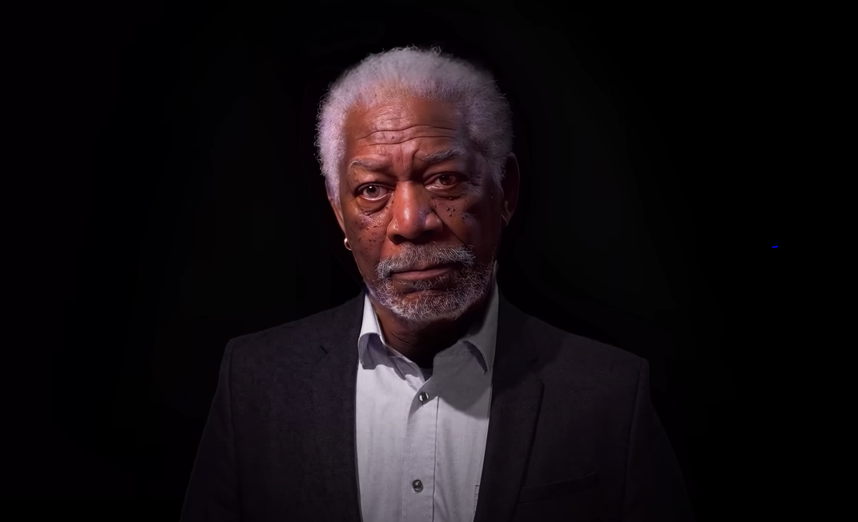
Where can you see this going?
This is not Morgan Freeman - A Deepfake Singularity - YouTube

